Slide 1
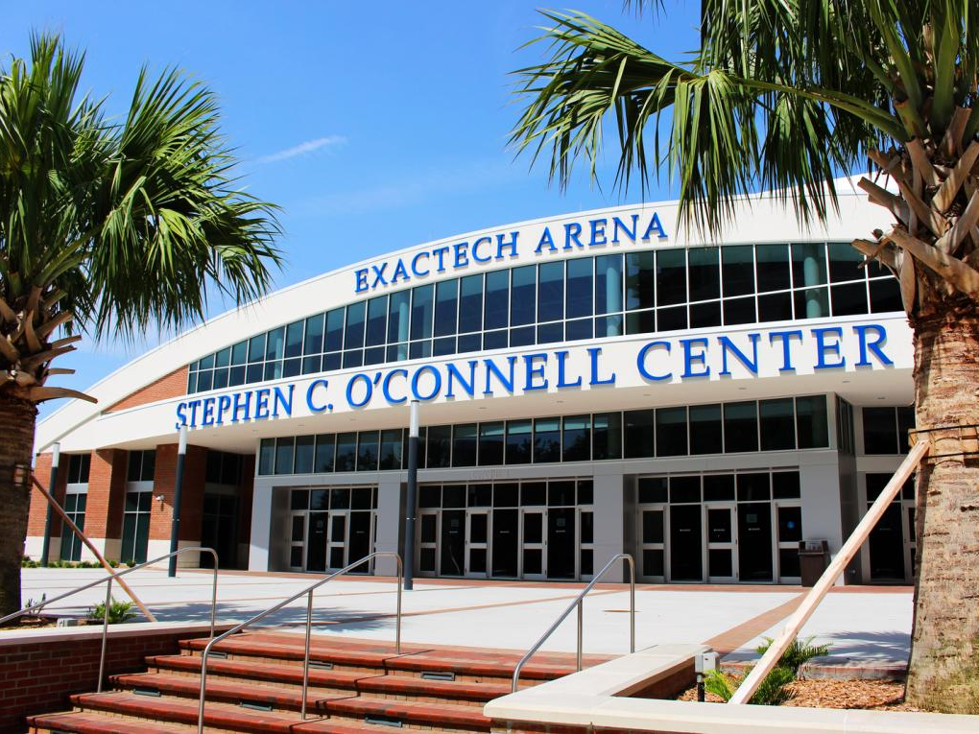
Prospective Employee Information

Slide 2
Who we are…
Multi-purpose facility with 15 full-time administrators and nearly 400 student employees
We facilitate a host of events including concerts, expos, speaking engagements, and athletics
We are home to eight Gator sports teams

Slide 3
Why Work Here…
One of the largest student employers on campus
Flexible hours in a dynamic and exciting work environment
Great networking opportunities
Convenient on-campus location
The opportunity for advancement

Slide 4
Part-Time Workforce
The O’Connell Center workforce is split into three categories of work:
Changeover
Event Staff
Technical
You are not required to work in just one division, but rather are welcome and encouraged to try all three! You are also not required to have any prior experience in these areas, we will provide all the training you will need.

Slide 5
Changeover
Changeover
Sets and strikes for every event
Setting up rails, tarps, curtains, chairs, tables, and more!
Arena clean up following events
Assemble and dissemble bleachers
Standby maintenance and cleanup during events
Setting and removing the hardwood volleyball and basketball floors, and gymnastics apparatuses

Slide 6
Event Staff
Frontline of our facility
First to greet patrons
Takes tickets, directs guests, and answers questions
Secures the building and its property:
Performs bag checks as patrons enter the facility
Works to diffuse difficult situations that may arise
Securing vital areas during events:
Backstage
Visiting team locker room
Main arena
Coordinates parking procedures during football game days
Enforces building policies

Slide 7
Technical
Serve as our in-house roadies
Set-up and take down:
Stages
Concert equipment (lighting/speakers)
Bandshell shows and small PA’s around campus
Load in/out plays and concerts
Training will be offered to all incoming employees.
*No Prior experience is required.

Slide 8
Work Requirements
You must work one holiday event shift per semester
Work a Homecoming shift during homecoming week
Commencement: work two shifts during Spring commencement and one shift during Fall commencement
You are expected to work at least 25 hours per month during our busy season (September-March)

Slide 9
Expectations
Work consistently and go above and beyond the minimum requirements
Always Exceed Expectations: E²
Arrive to work on time, properly dressed
Be pleasant, friendly, patient, and tolerant with our guests
Cooperate and communicate
All employees are to be professional and focused during all shifts regardless of how thrilling the environment may be

Slide 10
Application Process
So what's next?
Please take the time to submit an O’Connell Center part-time employee application via jobs.ufl.edu. MAKE SURE to attach your resume to your jobs.ufl.edu application
In the code space provided on the application enter the code “2019”
If your application is selected, you will be emailed for an interview during the next interview cycle which will occur after the closing date of the online job posting found on jobs.ufl.edu

Slide 11
Application process
Application tip: Please make sure to read the application carefully and fill it out completely. We take completion and attention to detail (i.e. misspelling and grammar errors) into consideration when reviewing applications.
If you have any questions at all, please contact scoc-hire@ufl.edu
Good luck and Go Gators!

