Slide 1
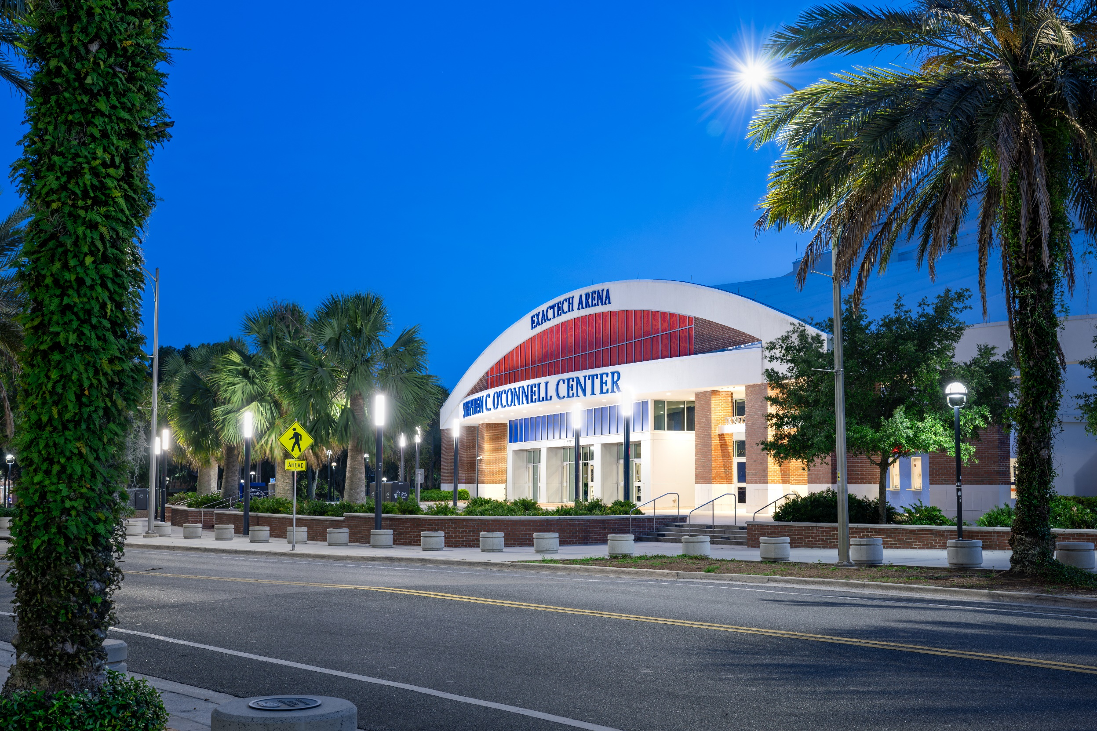
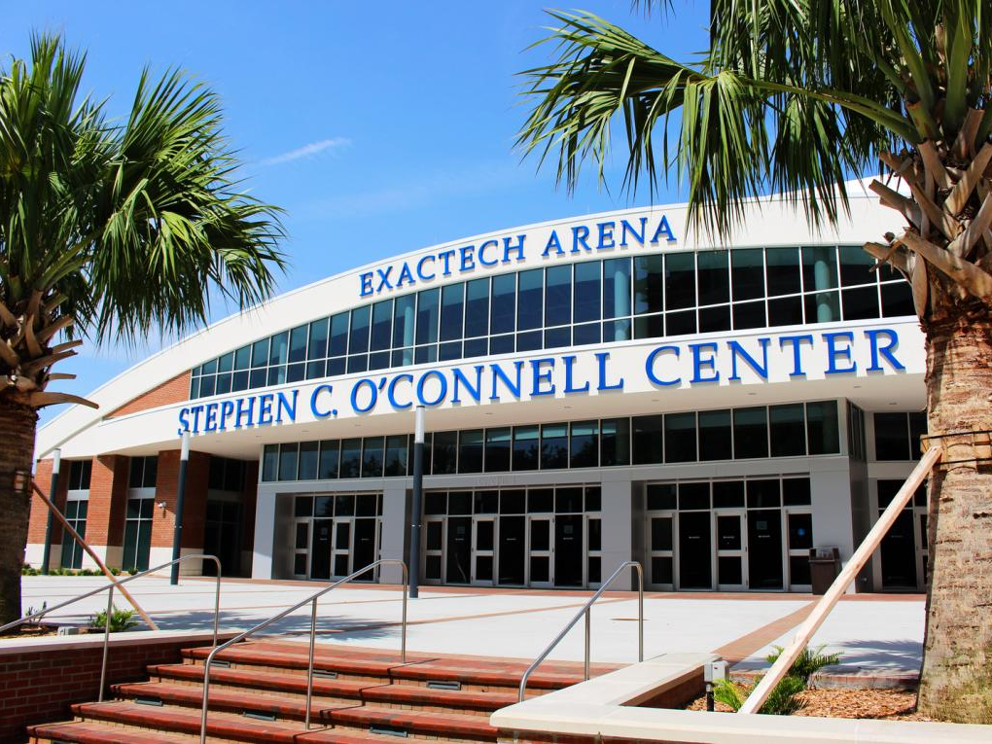
Prospective Employee Information

Slide 2
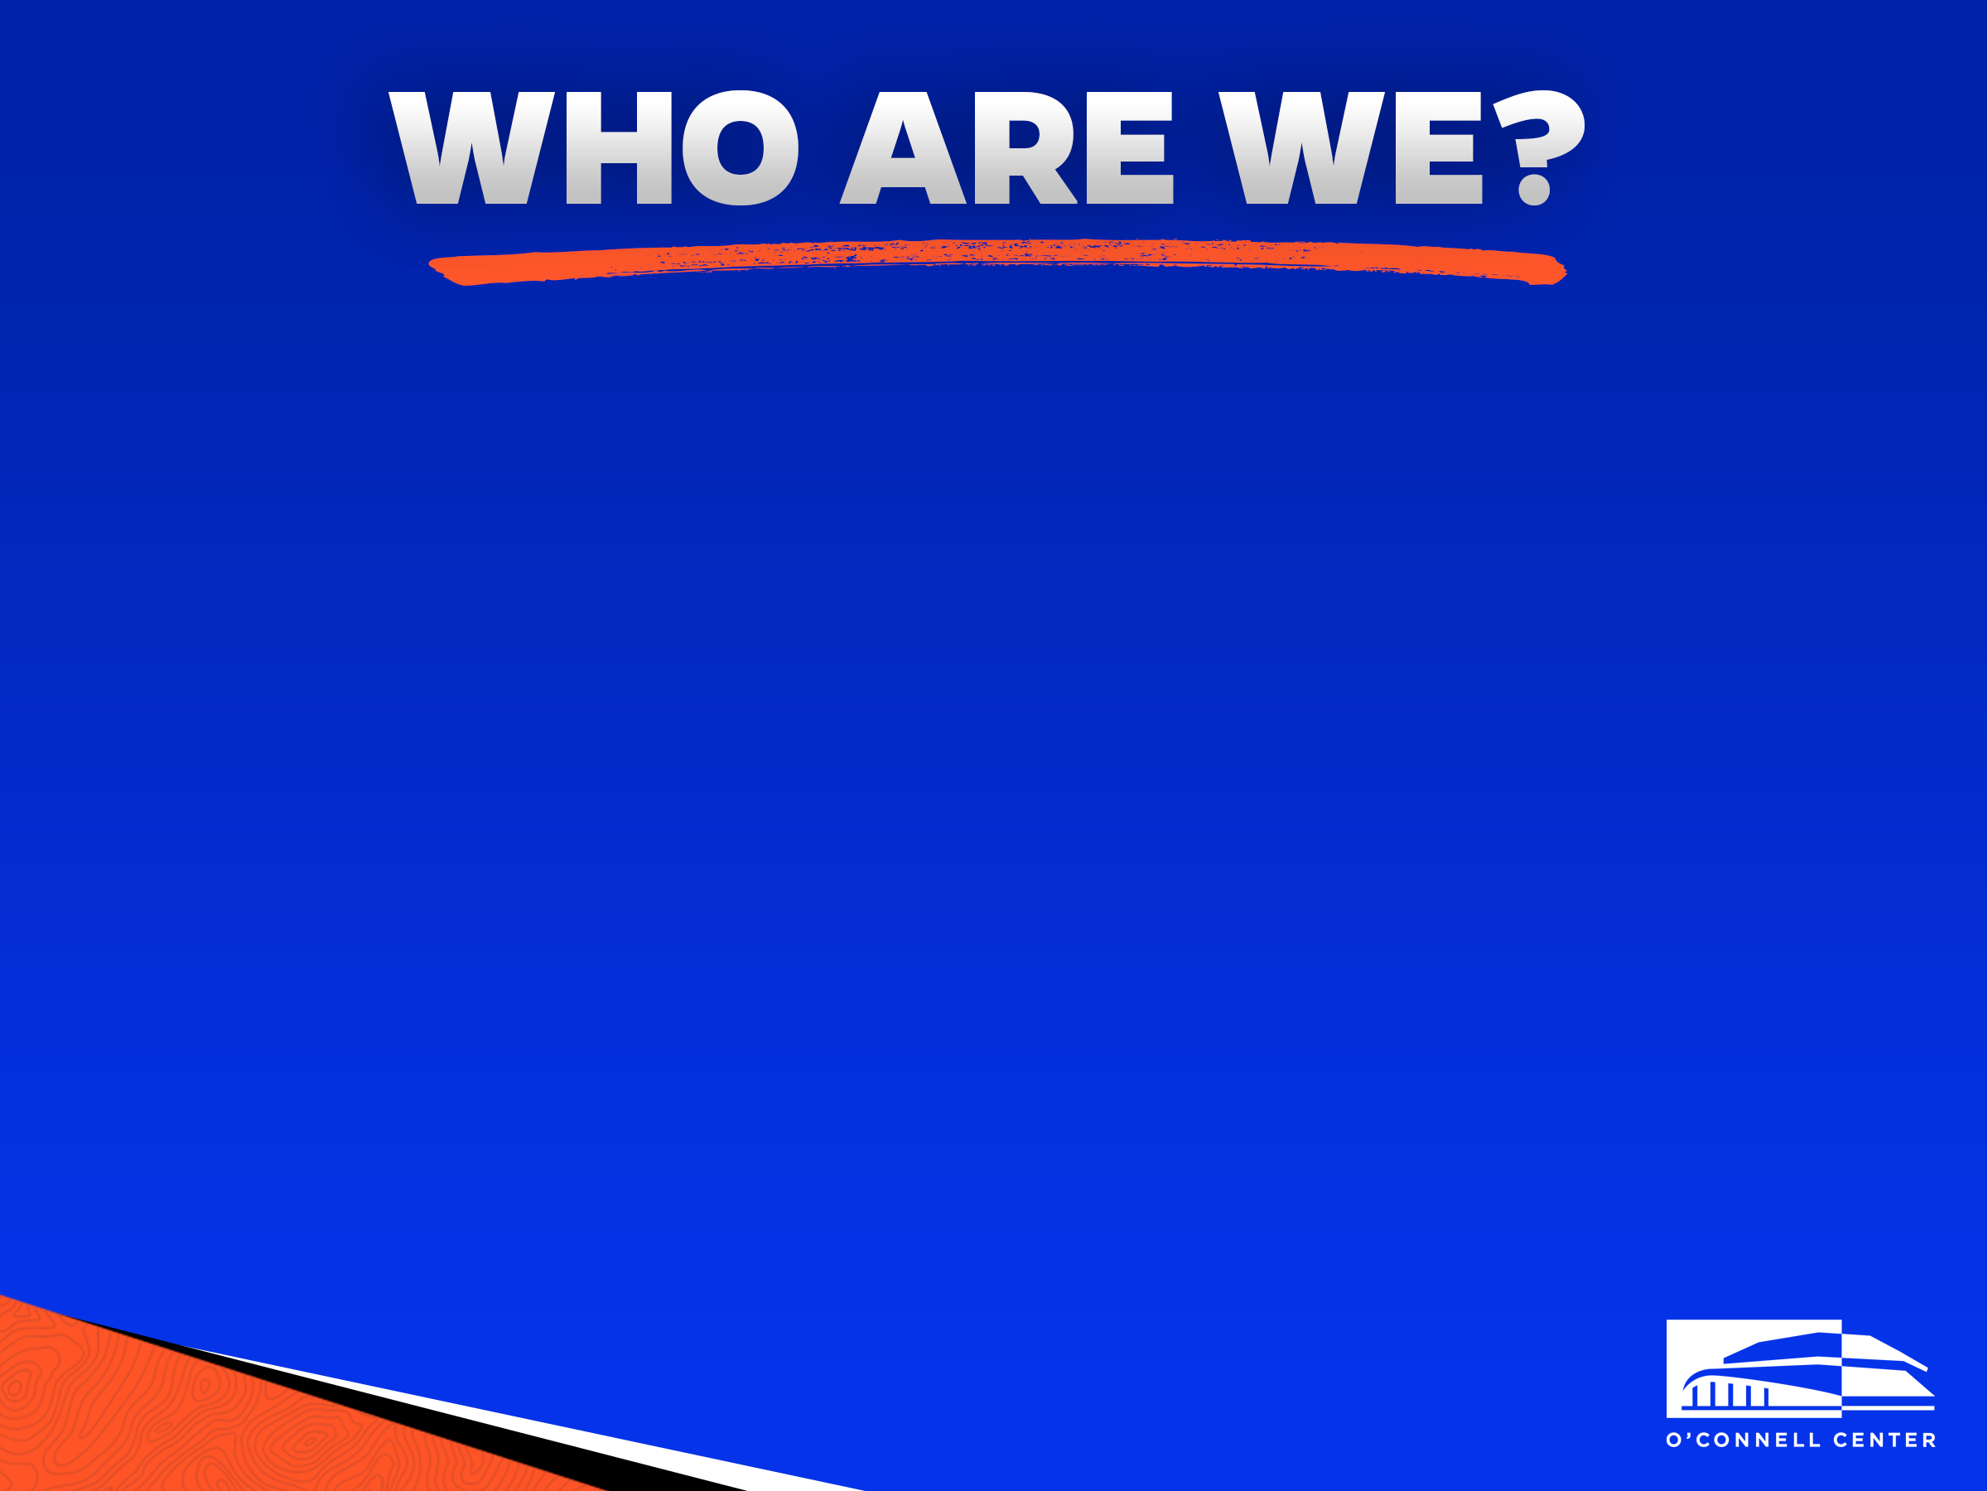


Multi-purpose facility with 20 full-time administrators and 250-350 student employees
We facilitate a host of events including concerts, expos, speaking engagements, and athletics
We are home to six Gator sports teams

Slide 3
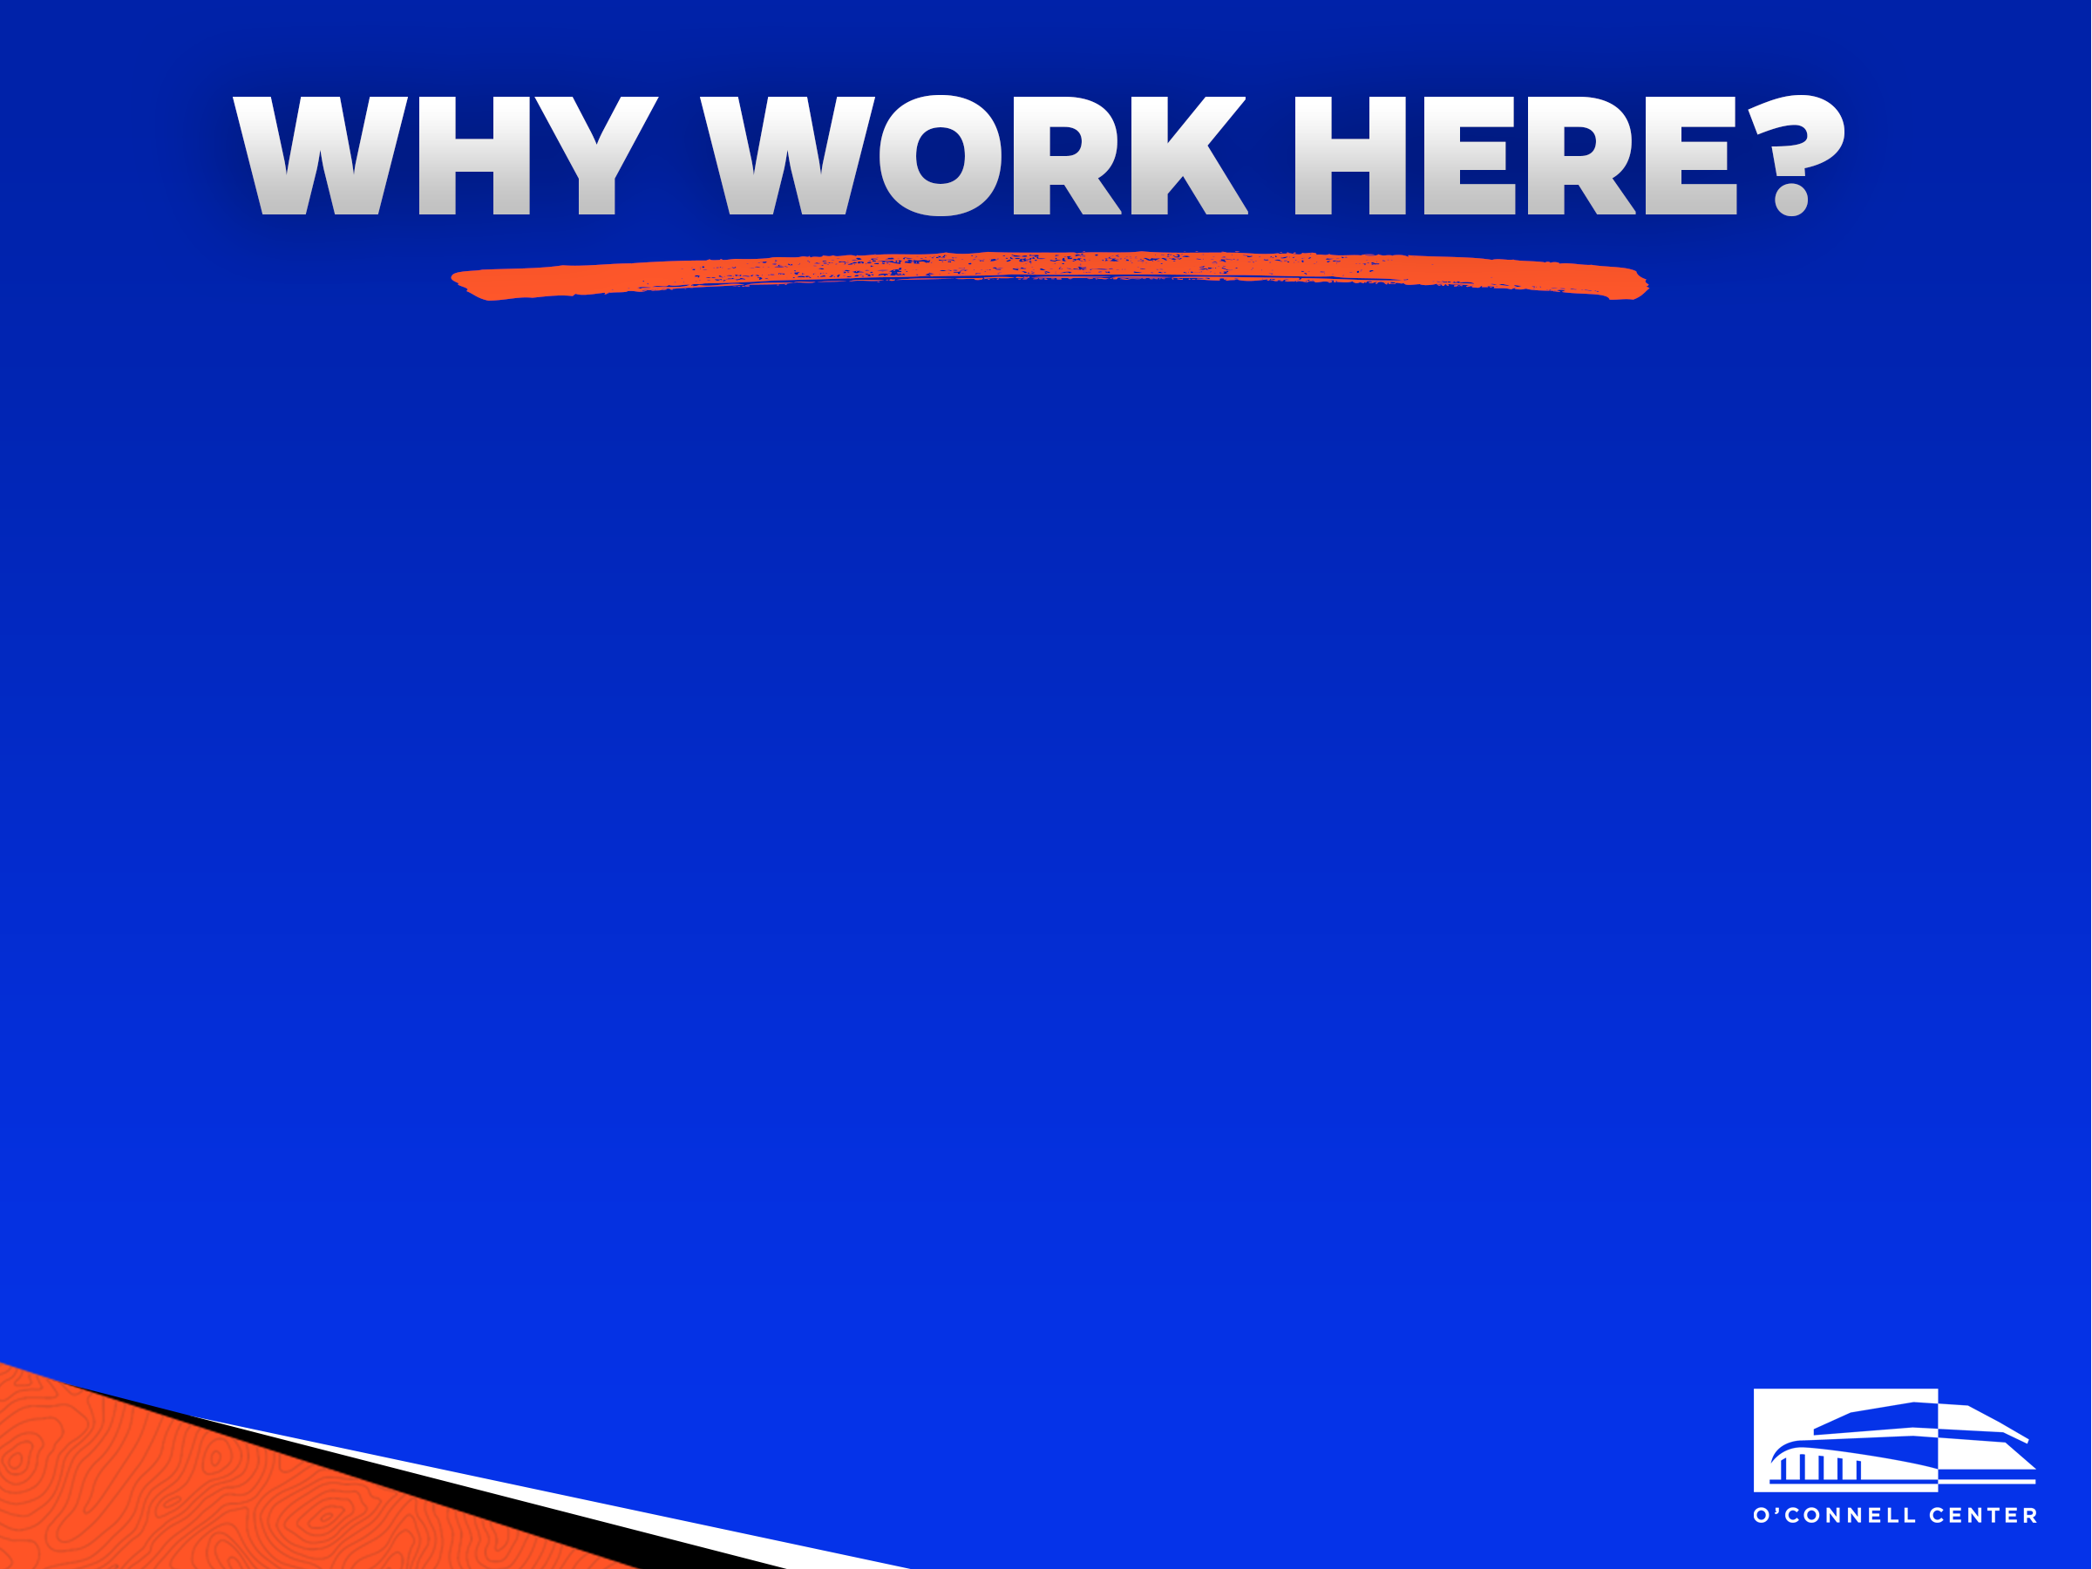
One of the largest student employers on campus
Flexible hours in a dynamic and exciting work environment
Great networking opportunities
Convenient on-campus location
The opportunity for advancement

Slide 4
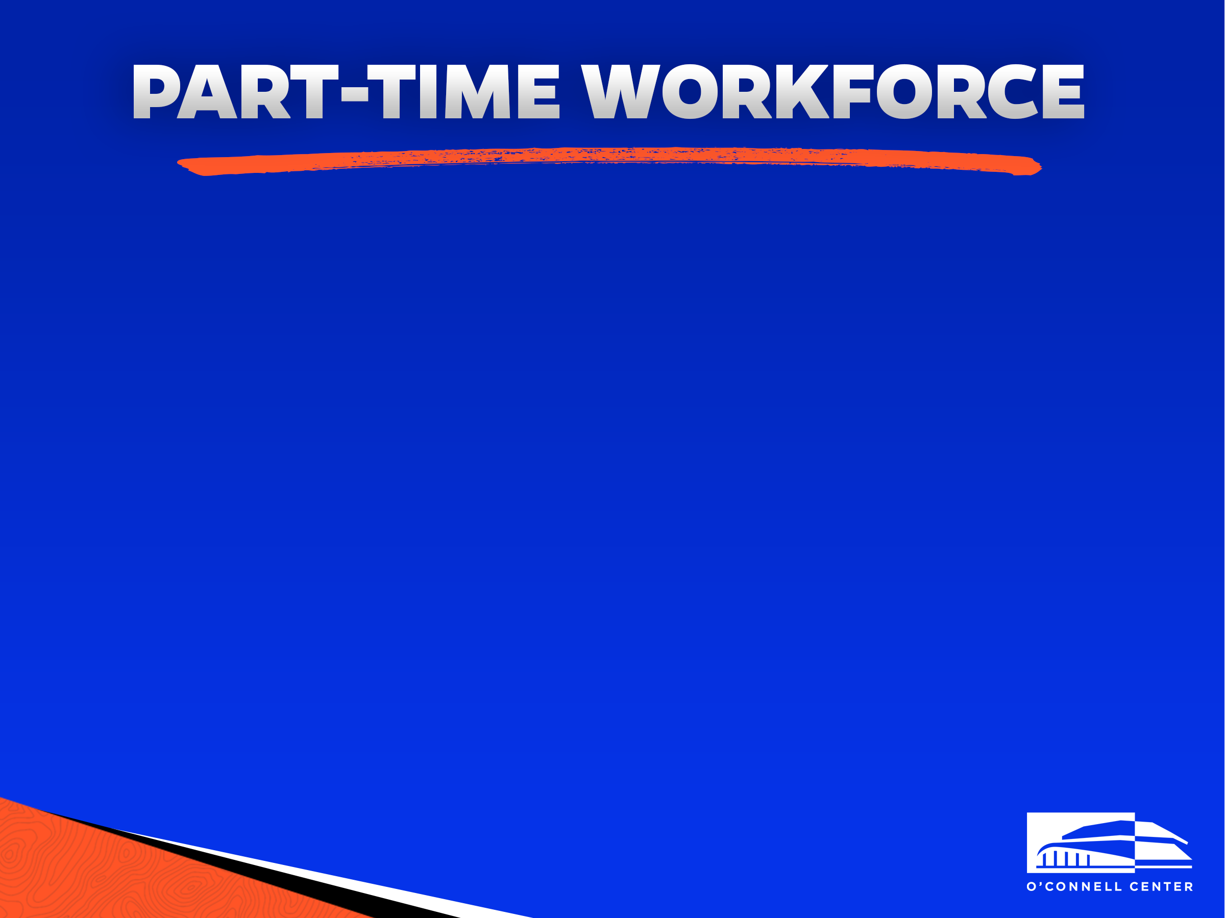
The O’Connell Center workforce is split into three categories of work:
Changeover
Event Staff
Technical
You are not required to work in just one division, but rather are welcome and encouraged to try all three!
You are also not required to have any prior experience in these areas, we will provide all the training you will need.

Slide 5
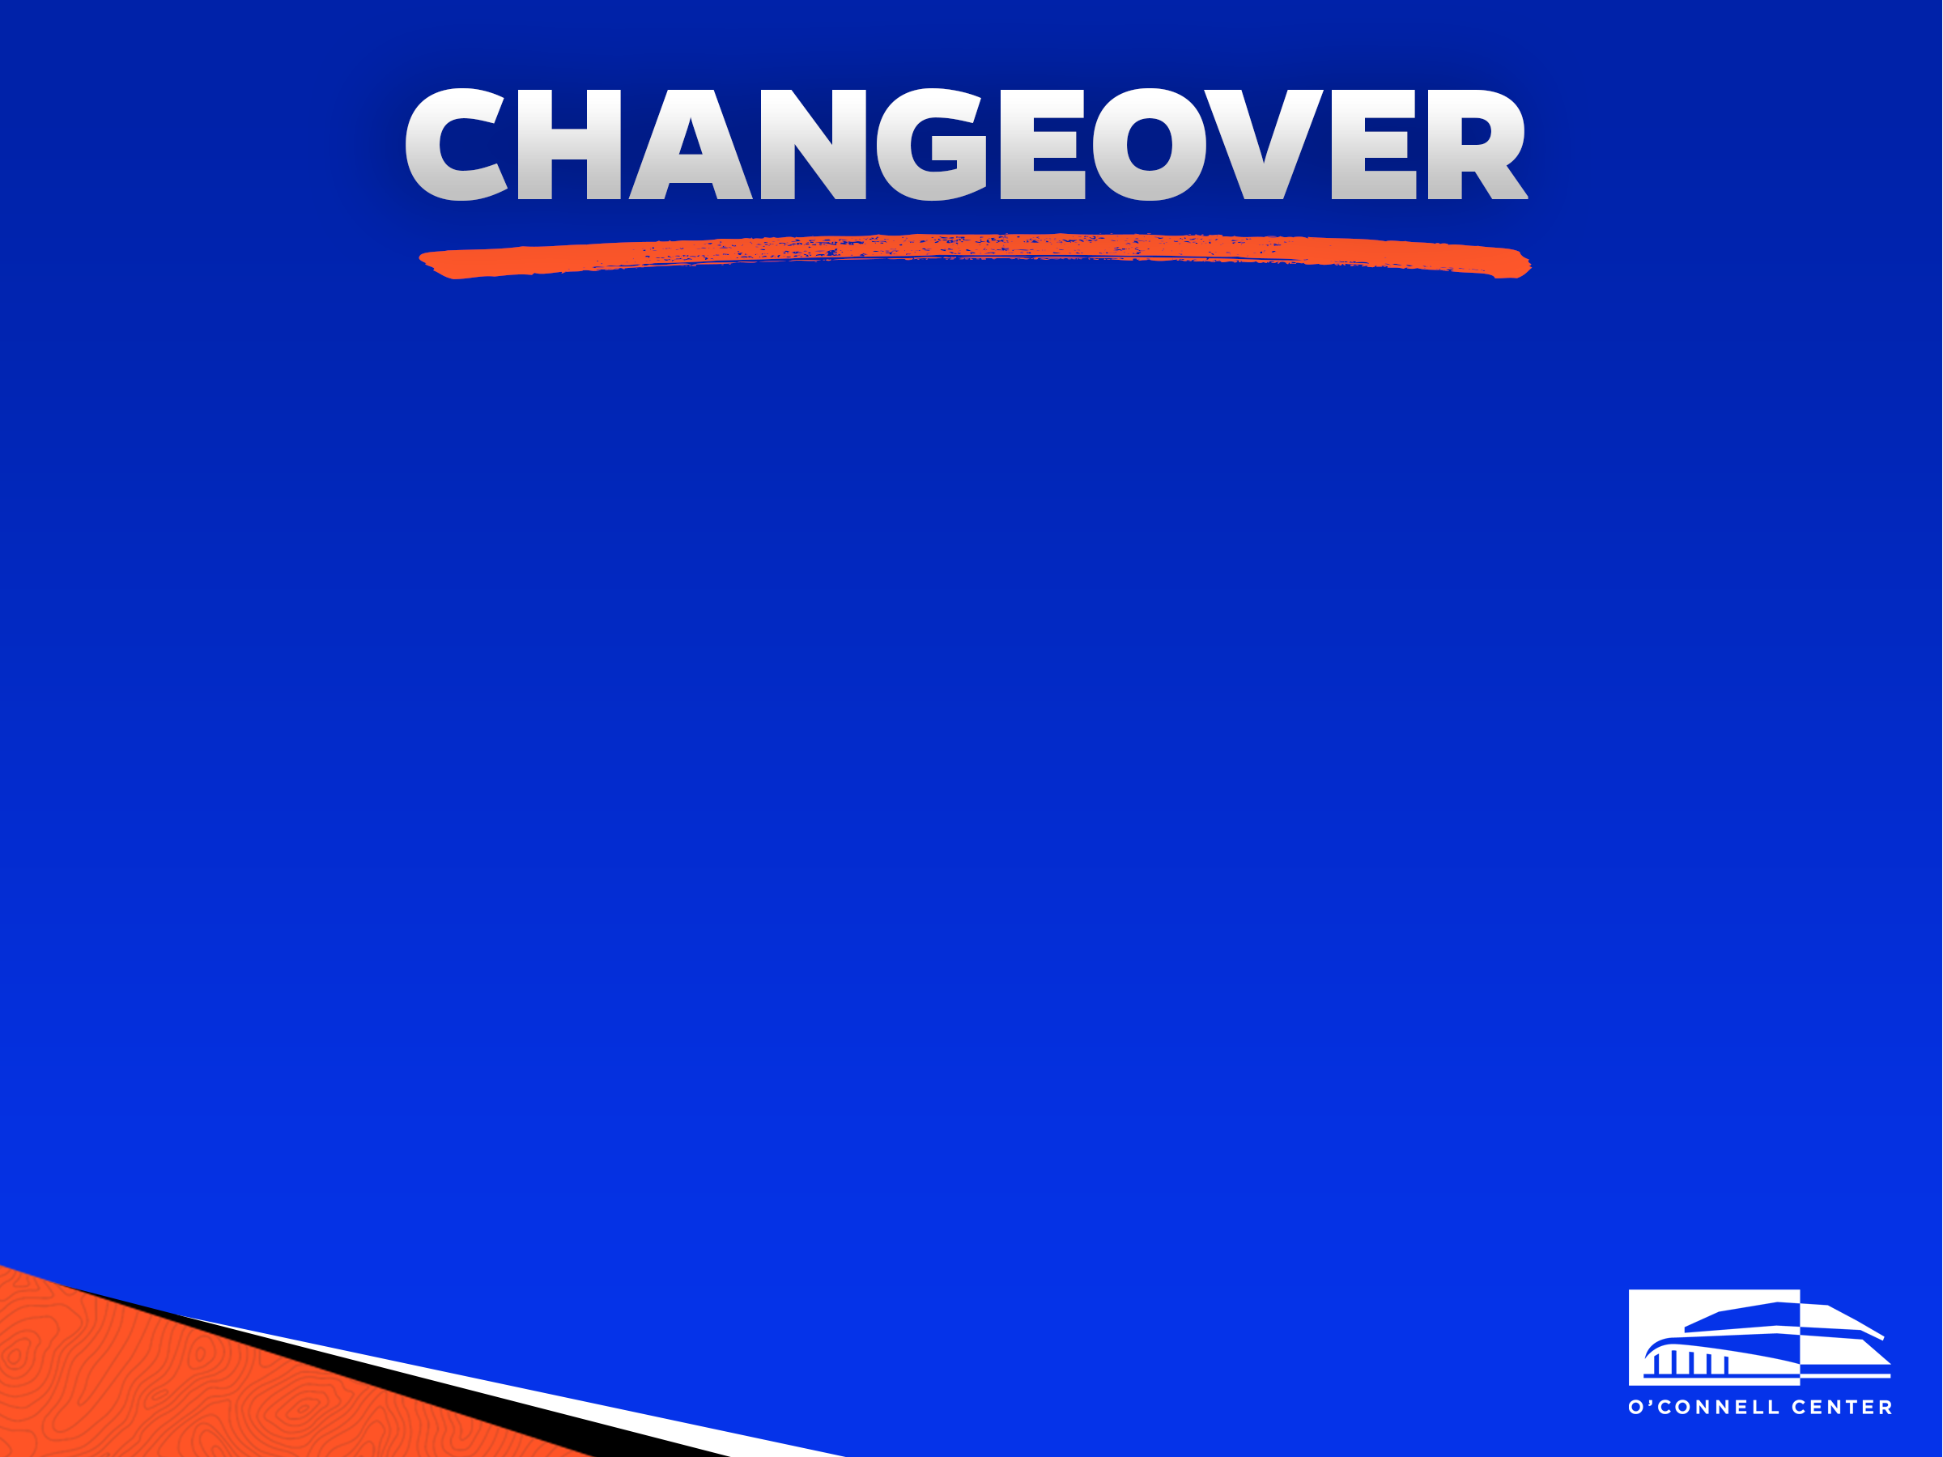
Sets and strikes for every event
  Setting up rails, tarps, curtains, chairs, tables, and more!
  Arena clean up following events
  Assemble and dissemble bleachers
  Standby maintenance and cleanup during events
  Setting and removing the hardwood volleyball and basketball floors, and gymnastics apparatuses

Slide 6

Frontline of our facility
First to greet patrons
Takes tickets, directs guests, and answers questions
Secures the building and its property:
  Performs bag checks as patrons enter the facility
  Works to diffuse difficult situations that may arise
Securing vital areas during events:
  Backstage
  Visiting team locker room
  Main arena
Coordinates parking procedures during football game days
Enforces building policies

Slide 7

Serve as our in-house roadies
Set-up and take down:
  Stages
  Concert equipment (lighting/speakers)
Bandshell shows and small PA’s around campus
Load in/out plays and concerts
Training will be offered to all incoming employees.
  *No Prior experience is required.

Slide 8
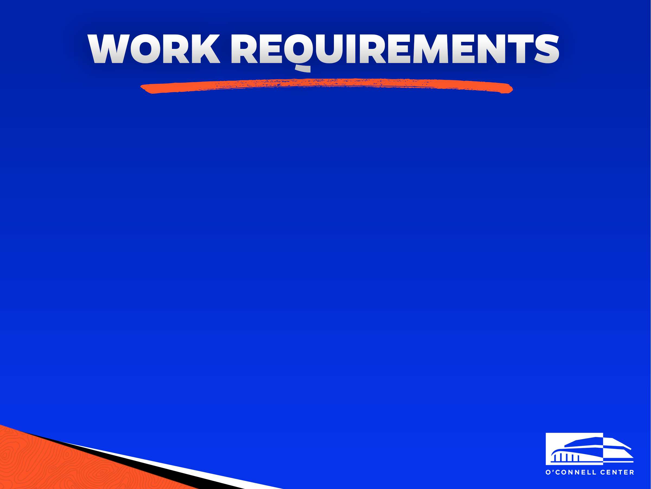
Monthly Requirements (Fall and Spring Semesters)
Work 25 hours per month
Sign the b-weekly every 2 weeks
Fall Requirements
Work at least 2 football shifts
  2 shifts, midnight to midnight, on home football game days
Work at least 1 holiday shift
  Holiday shifts are anytime the university is closed (i.e. Labor Day, Thanksgiving Break, MLK Day, etc.)
Work at least 1 commencement shift
Spring Requirements
Work at least 1 holiday shift
Work at least 2 commencement shifts

Slide 9

Work consistently and go above and beyond the minimum requirements
Always Exceed Expectations: E²
Arrive to work on time, properly dressed
Be pleasant, friendly, patient, and tolerant with our guests
Cooperate and communicate
All employees are to be professional and focused during all shifts regardless of how thrilling the environment may be

Slide 10
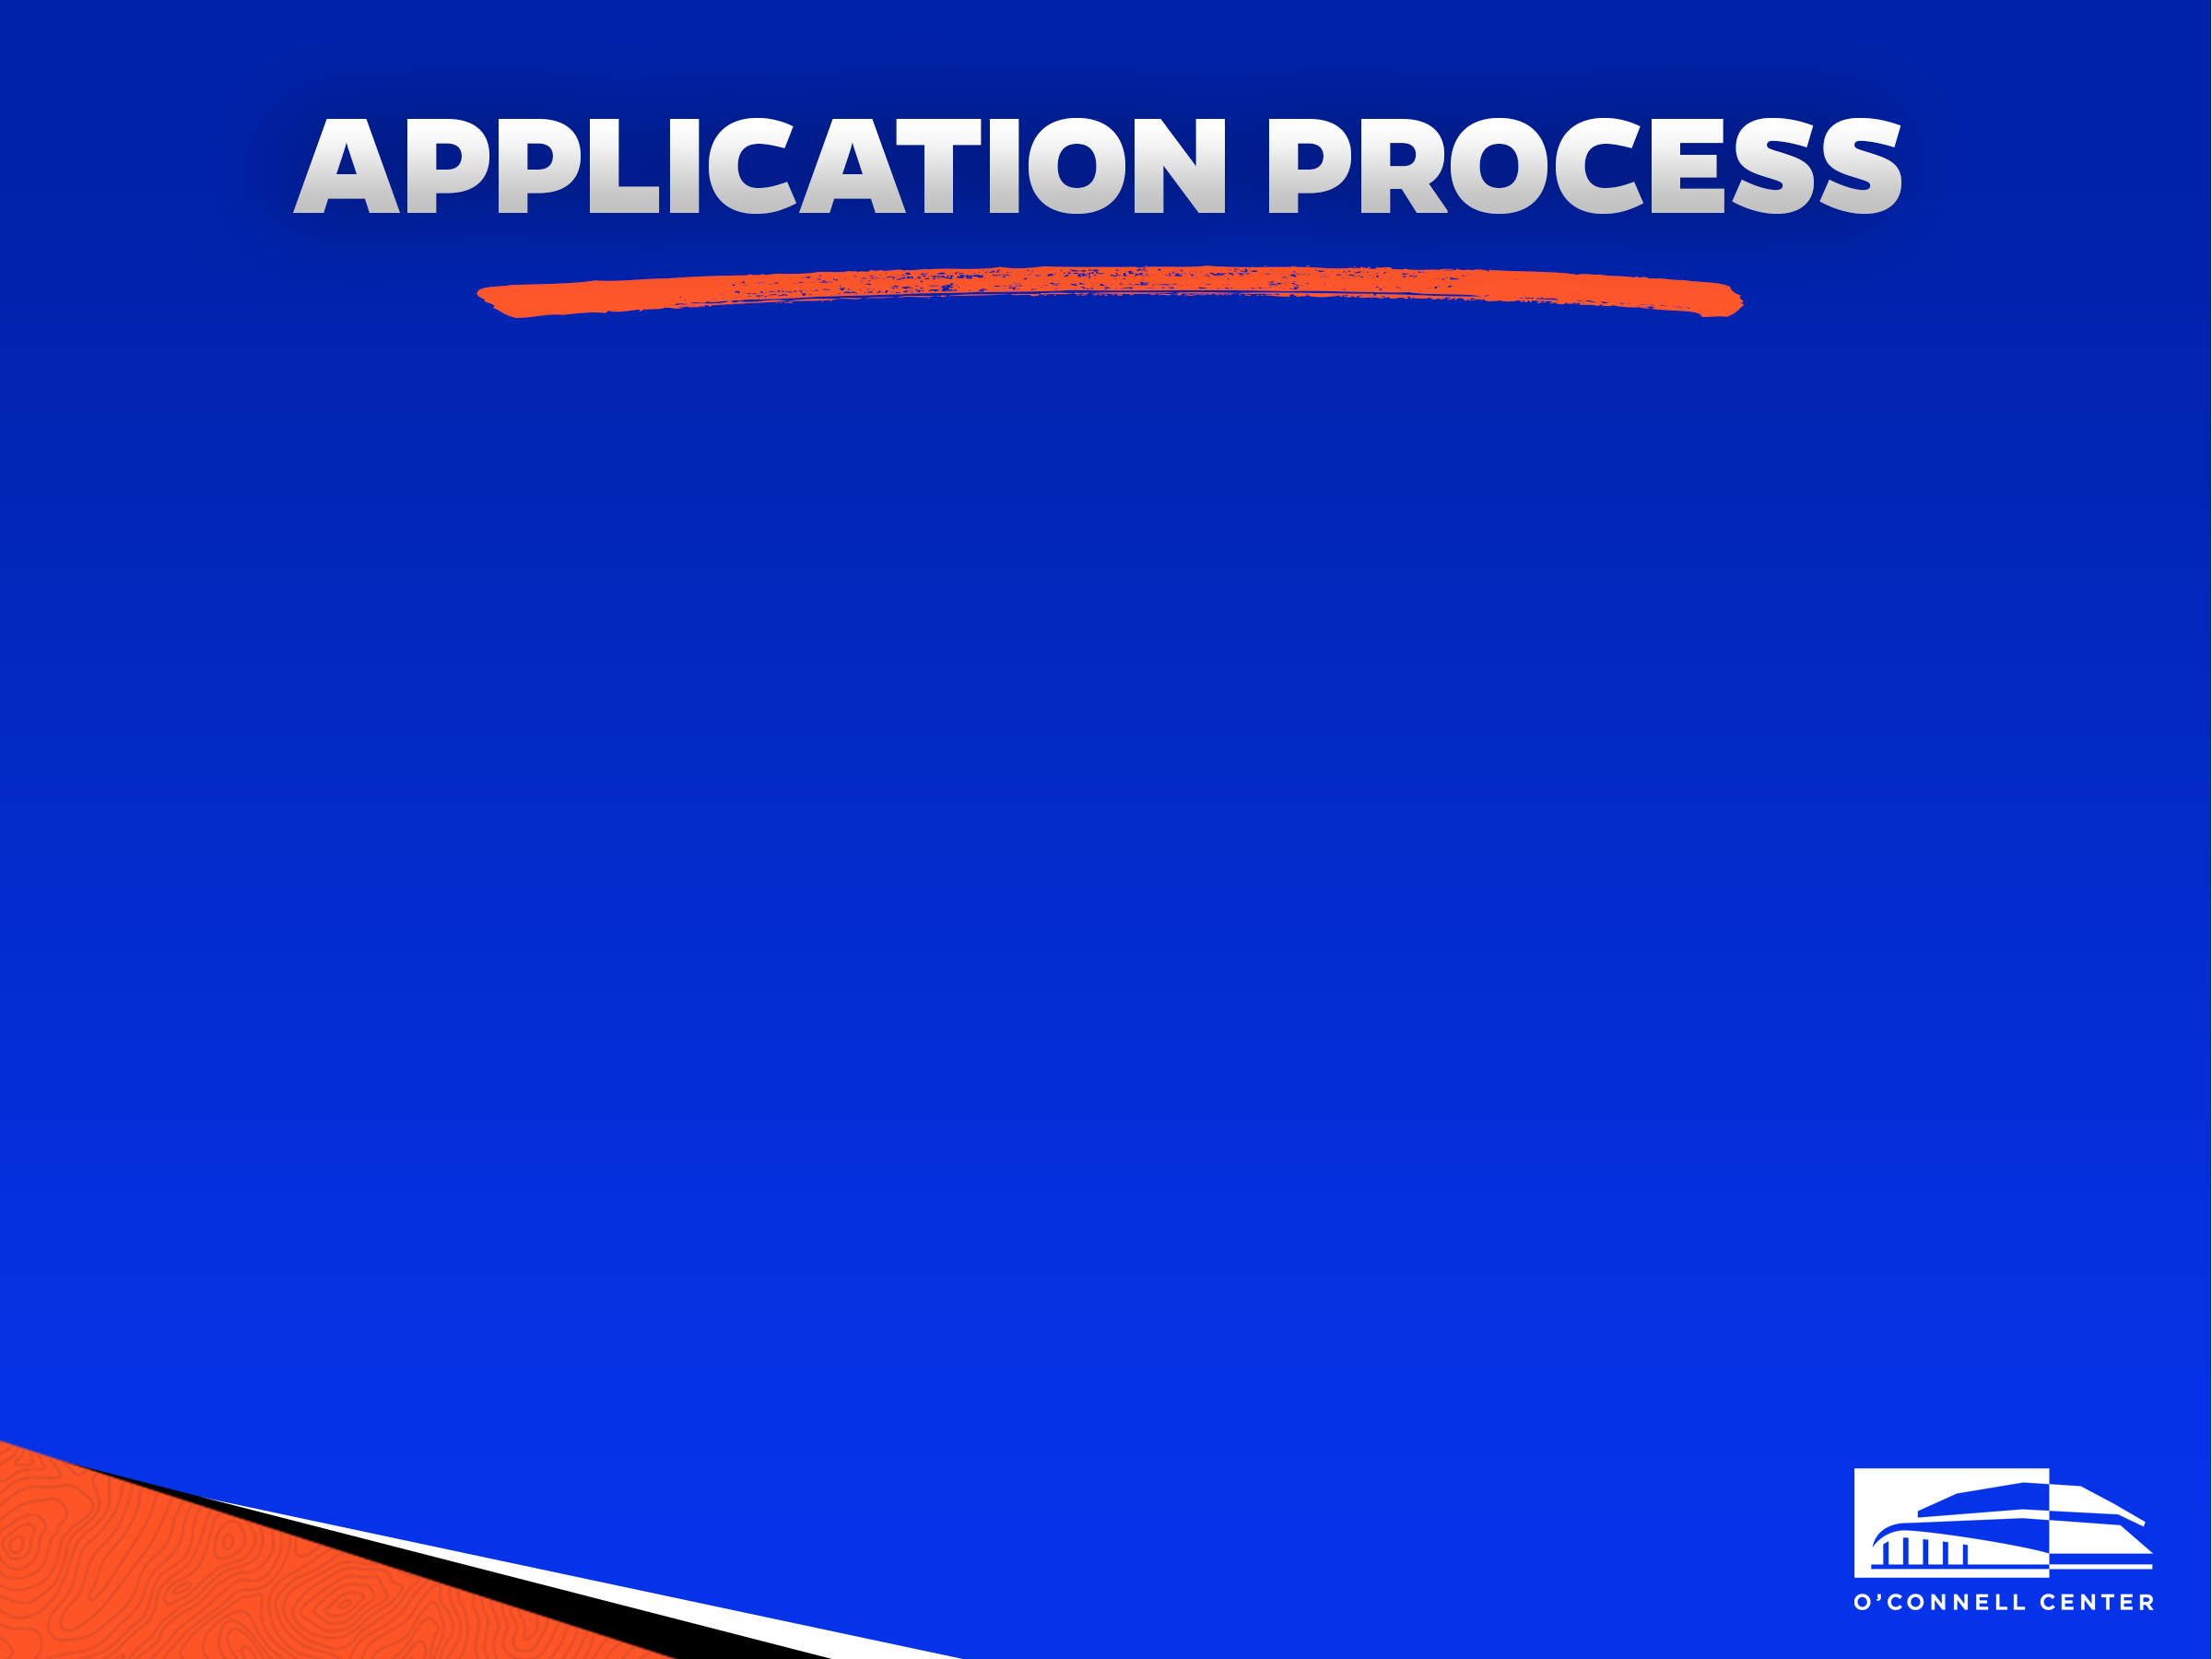
So, what's next?
Please take the time to submit an O’Connell Center part-time employee application via jobs.ufl.edu. MAKE SURE to attach your resume to your jobs.ufl.edu application
If your application is selected, you will be emailed for an interview during the next interview cycle which will occur after the closing date of the online job posting found on jobs.ufl.edu

Slide 11
Application tip: Please make sure to read the application carefully and fill it out completely. We take completion and attention to detail (i.e. misspelling and grammar errors) into consideration when reviewing applications.
If you have any questions at all, please contact scoc-hire@ufl.edu
Good luck and Go Gators!

